Slide 1

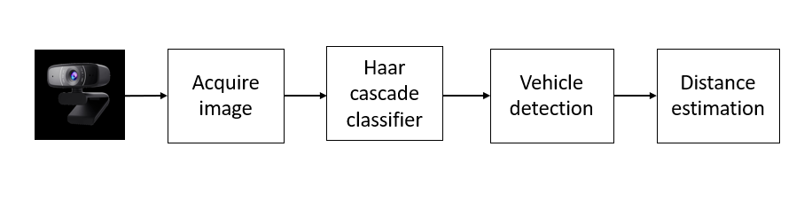
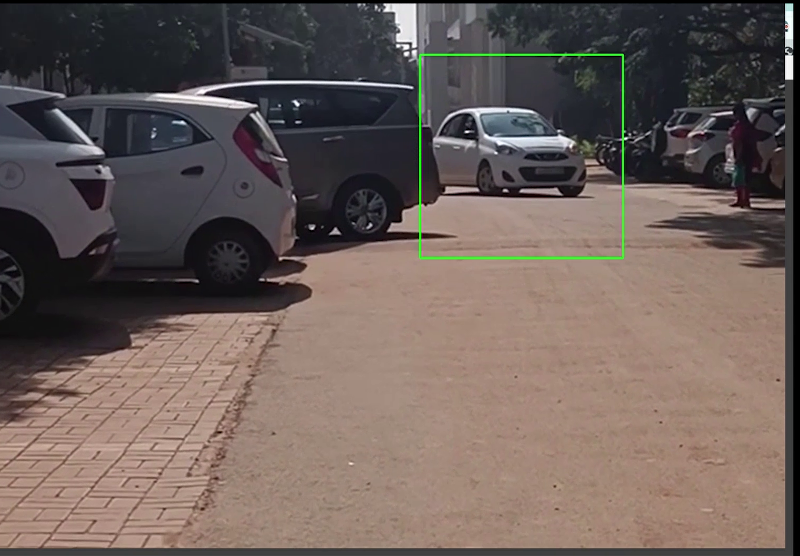
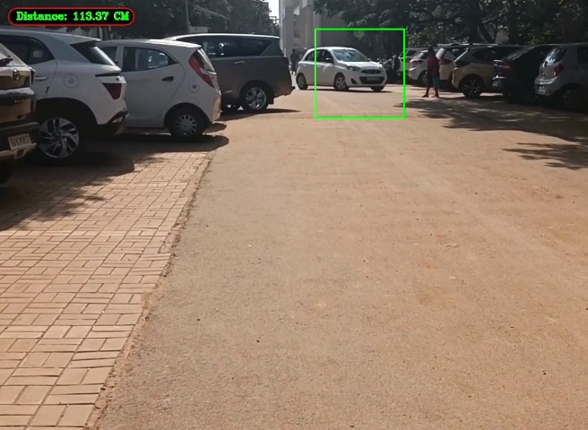
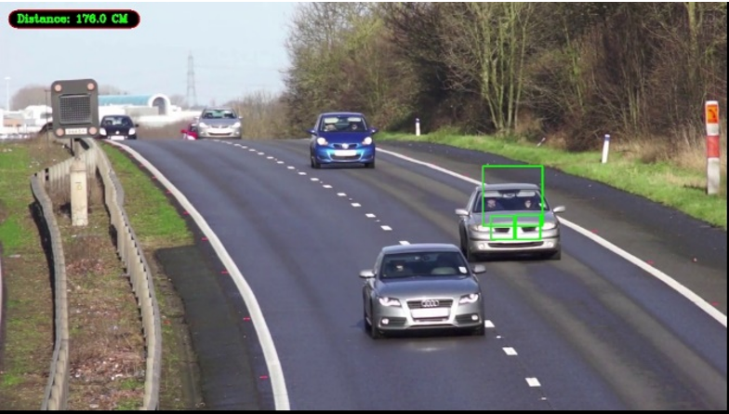
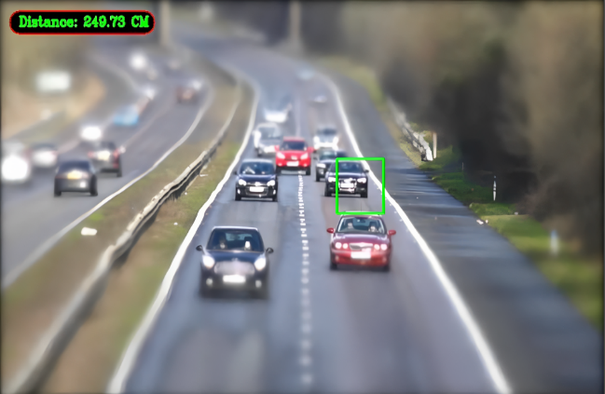
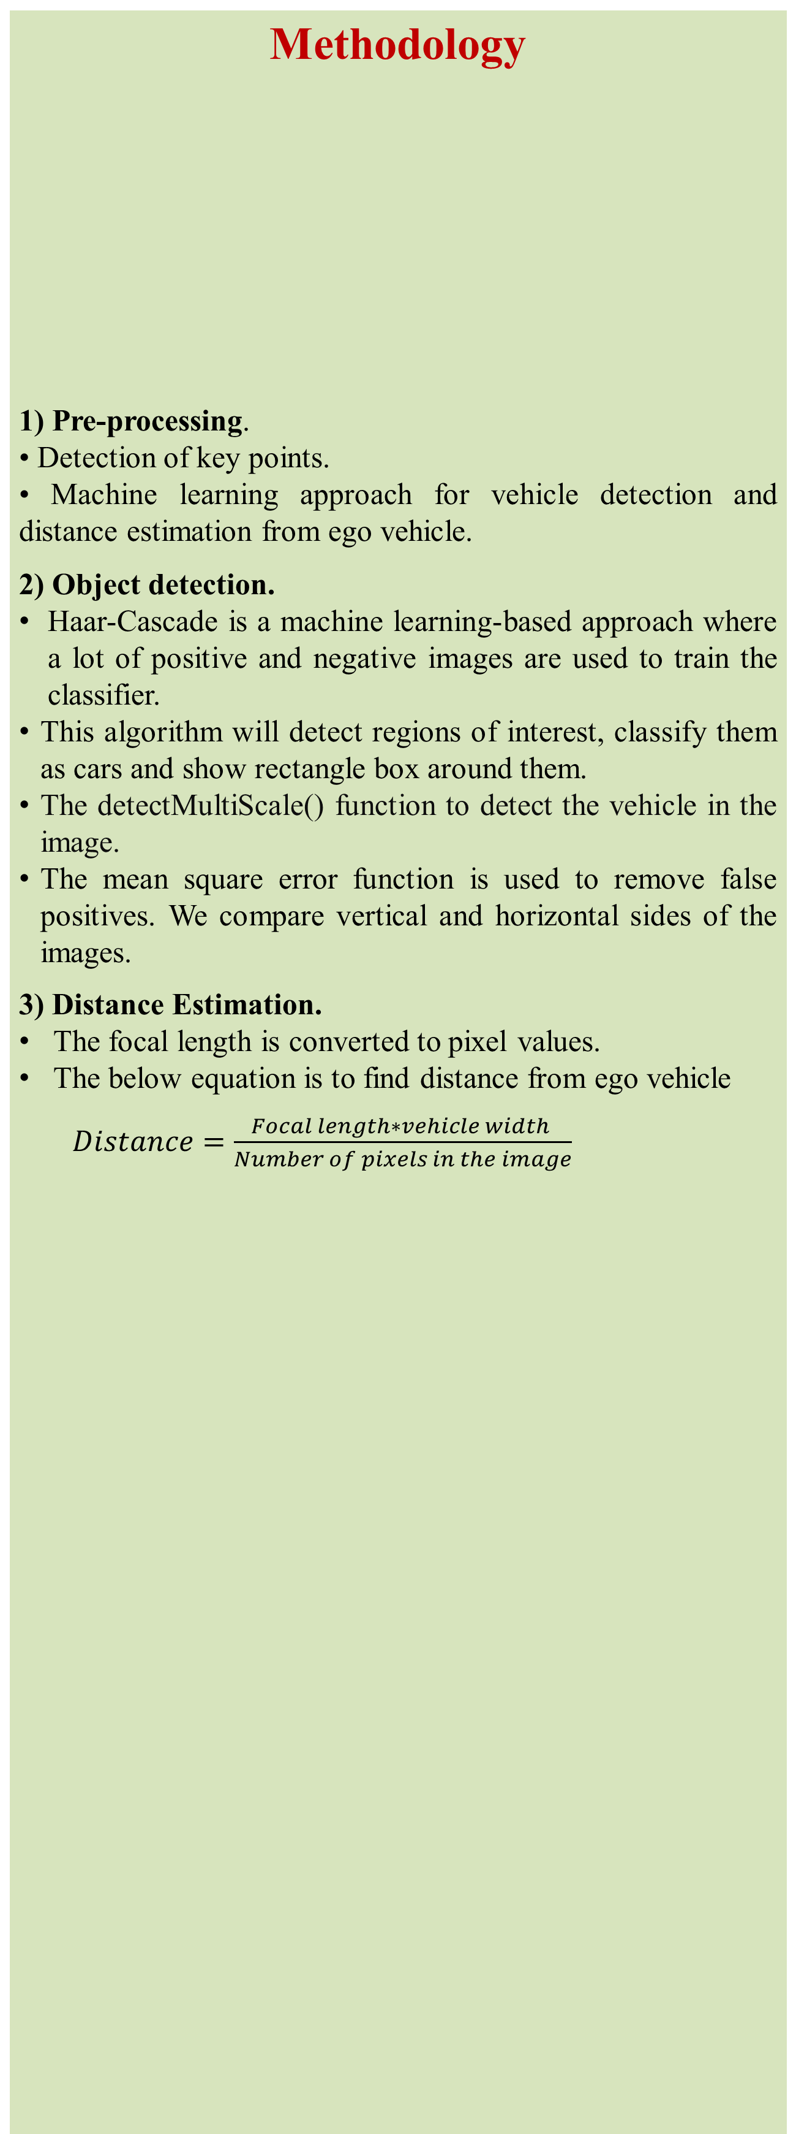
Forward Collision Avoidance using Monocular Camera for Autonomous Vehicles
Team 12:Aarya K.H., Lalita J.S., Sahana B.S., Abhishek S.
Guide: Prof. Gireesha H.M.
School of Electronics and Communication Engineering
Problem statement
Methodology
1) Pre-processing.
• Detection of key points.
• Machine learning approach for vehicle detection and distance estimation from ego vehicle.
2) Object detection.
Haar-Cascade is a machine learning-based approach where a lot of positive and negative images are used to train the classifier.
This algorithm will detect regions of interest, classify them as cars and show rectangle box around them.
The detectMultiScale() function to detect the vehicle in the image.
The mean square error function is used to remove false positives. We compare vertical and horizontal sides of the images.
3) Distance Estimation.
The focal length is converted to pixel values.
The below equation is to find distance from ego vehicle
$Distance=\frac{Focal length∗vehicle width }{Number of pixels in the image}$
Results
Real time object detection and distance estimation using monocular camera for autonomous vehicles.
Vehicle detection and estimation of the distance are shown below:
Objectives
Feature identification and extraction for accurate vehicle detection .
Real time distance estimation of the vehicle from the ego vehicle.
Figure 1: Block diagram for real time distance measurement
Vehicle detection
Distance:113.37cm
Contributions
Distance:176.0cm
Distance:249.73cm
The real time distance estimation using monocular camera.
Conclusions
We were successfully able to identify the vehicles and obtain the real time distance of the detected vehicle from the ego vehicle. In order to achieve this, we used Haar-cascade algorithm for feature extraction and multiscale algorithm is used for vehicle detection based machine learning based approach. The model detect vehicle and estimate distance within 10 m, with the accuracy of 84%.
Literature survey
•ToF (Time-of-Flight) camera based forward collision avoidance system .
•Forward collision warning with a monocular camera.
•An efficient device for forward collision warning using low cost stereo camera.
Mini Project-2022-23

